Slide 1



Slide 2


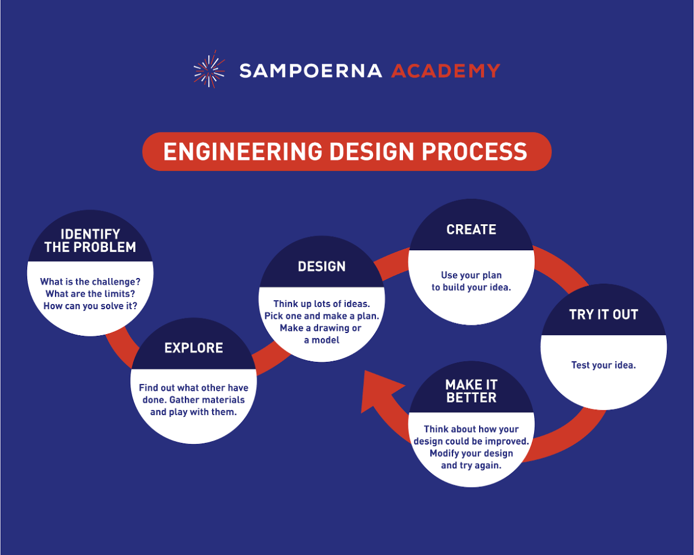

Slide 3
Project Title:
Research Question:
Student Name(s):
Grade / Class
Category: Engineering Design
Teacher / Coach Name:

Slide 4
Define the Problem
Ask yourself:
What is the challenge? There are a lot of challenges I can face in this project like getting the right materials, understanding the concept behind this, design, etc.
What are the limits?
How can you solve it? Using professional help, handling the materials properly,
(State your problem here)

Slide 5
Define the Problem
Find out what others have done: There are many other kinds of ideas similar to this such as solar desalination, Solar UV Water Purifier, Solar Pump for Water Filtration, etc. The one prepared here is a Solar Powered water purification system.
Set design criteria:
Give very specific criteria for your design, remember you will test for them later!
(State your criteria here)

Slide 6
Plan / Design
Think up lots of ideas.
Pick one and make a plan
(Share your plan here)

Slide 7
Plan / Design
Make a drawing or simple model.
(upload design here)

Slide 8
Plan / Design
Identify Materials needed to build it
(upload pictures of materials here)

Slide 9
Create
Build a prototype
(Upload at least 6 pictures of building/creating or fast-track video here)

Slide 10
Try it Out
Test your prototype.
Data from testing must be tabulated and graphed.
(Upload at least 6 pictures of testing or fast-track video here)

Slide 11
Make it Better
Think about how your design could be improved. Modify your design and try again.
Data from your second test must be tabulated and graphed
(Upload at least 6 pictures of retesting here or a fast-track video here)

Slide 12
Communicate
Presentation complete!
(Make sure presentation it is complete, neat, and presentable)
Next, we will work on our videos.

