Slide 1



Slide 2


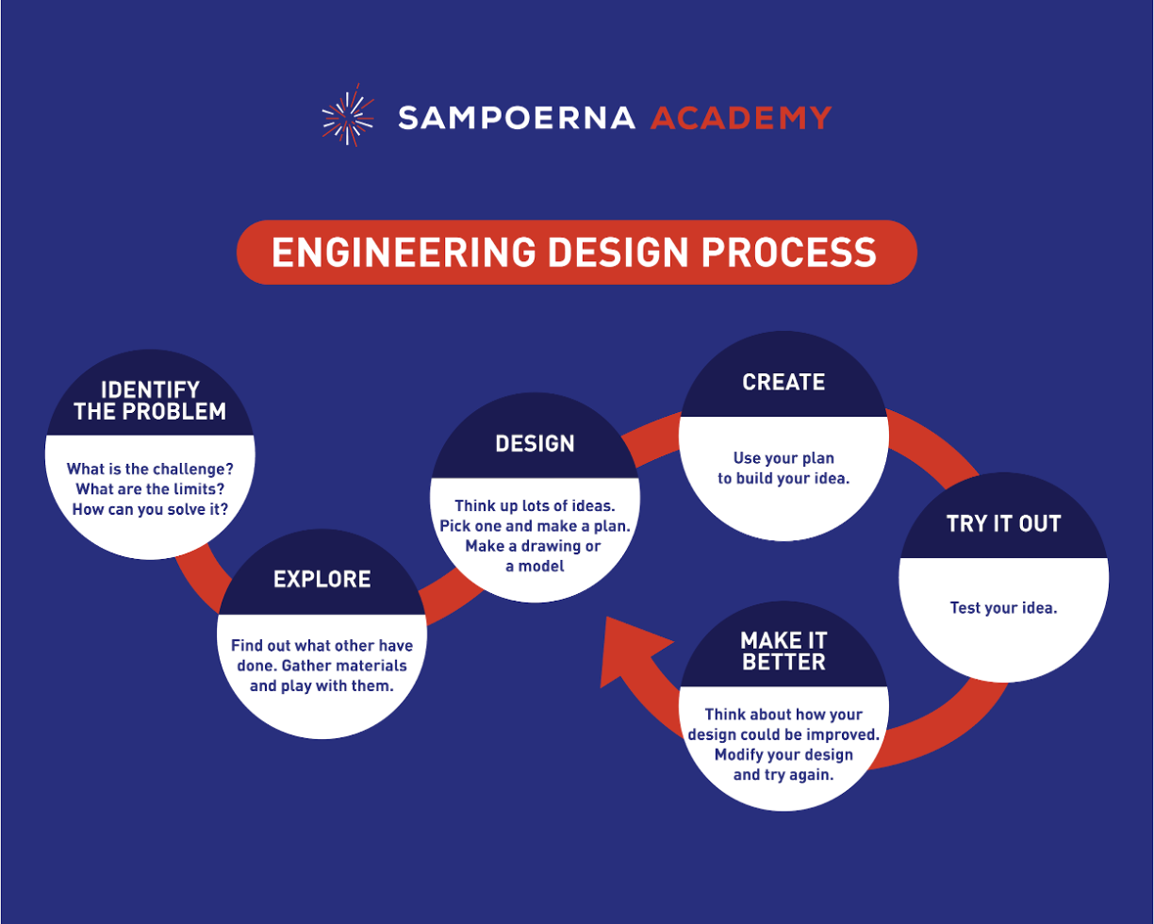

Slide 3
Project Title:
Research Question:
Student Name(s):
Grade / Class
Category: Engineering Design
Teacher / Coach Name:

Slide 4
Identify the Problem
Ask yourself:
●What is the challenge? There are a lot of challenges I can face in this project like getting the right materials, understanding the concept behind this, design, etc.
●What are the limits?
●How can you solve it? Using professional help, handling the materials properly,
(State your problem here)

Slide 5
Explore and Research
●Find out what others have done: There are many other kinds of ideas similar to this such as solar desalination, Solar UV Water Purifier, Solar Pump for Water Filtration, etc. The one prepared here is a Solar Powered water purification system.
●My design criteria (Goals to Achieve): Give very specific criteria for your design, remember you will test for them later! (State your criteria here)
●Sources Used:

Slide 6
Plan & Design
●Step-by-Step Plan.
●Materials Needed: Identify Materials needed to build it (upload pictures of materials here)

Slide 7
Create (Build Prototype)
●Make a drawing or simple model.
(upload design here)

Slide 8
Create
●Build a prototype
(Upload at least 6 pictures of building/creating or fast-track video here)

Slide 9
Try it Out
●Test your prototype.
●Data from testing must be tabulated and graphed.
(Upload at least 6 pictures of testing or fast-track video here)

Slide 10
Make it Better
●Think about how your design could be improved. Modify your design and try again.
●Data from your second test must be tabulated and graphed
(Upload at least 6 pictures of retesting here or a fast-track video here)

Slide 11
Communicate
Presentation complete!
(Make sure presentation it is complete, neat, and presentable)
Next, we will work on our videos.

